Slide 1
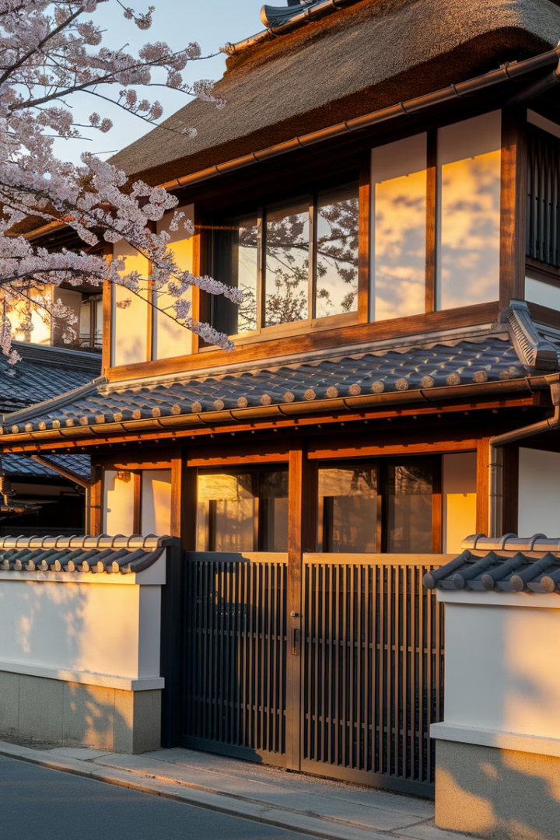
Akiya Reborn: Forgotten Homes, Future Stories
Welcome to Akiya Reborn, where we turn empty homes in Japan into living spaces for the future. Our mission: "忘れられた家に、次の物語を" (Bringing new stories to forgotten homes). We use Web3 and community funding to solve Japan's empty house problem while creating great experiences for travelers.
Join Team Shqiponja as we connect traditional Japanese housing with new blockchain technology to bring life back to communities and build links between property owners, investors, and travelers. TEAM : Shqiponja

Slide 2
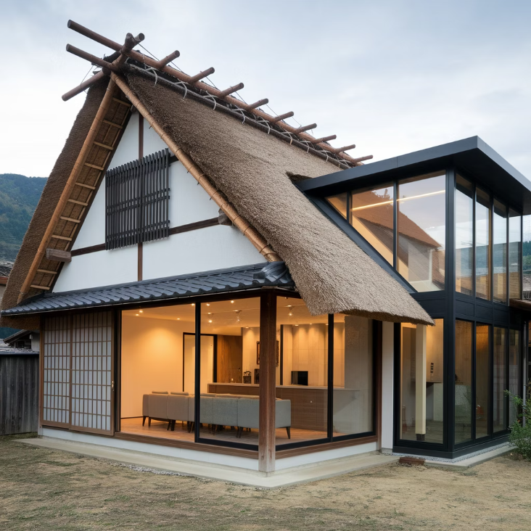
The Growing Problem of Vacant Houses in Japan
The Crisis in Numbers
Japan has 8.49 million empty homes nationwide, making up over 13% of all housing. These empty houses, called "akiya," are growing in number as people leave rural areas for cities.
While these houses sit empty, foreign tourists find it hard to get authentic places to stay in popular areas. This creates a gap between what's available and what's needed, hurting local economies. For homeowners, these empty houses cost money to maintain and create tax problems. At the same time, visitors from other countries want to experience real Japanese culture beyond regular hotels. This is an opportunity to build cultural connections and help local economies.

Slide 3




Our Web3 Solution to Revitalize Vacant Houses
Community Investment
Transparent Renovation
Exclusive Utilization
Supporters purchase NFTs that represent fractional ownership in akiya renovation projects, providing necessary funding while gaining access to future accommodations.
Renovation process is documented on-chain, allowing supporters to witness the transformation journey and participate in key decisions through DAO voting.
NFT holders gain priority access to stays, community events, and cultural experiences in the renovated properties, creating ongoing utility.
What makes our approach unique is the immersive experience throughout the renovation process. Supporters don't just fund a project—they become part of its story, watching as traditional craftsmanship transforms forgotten spaces into vibrant community hubs, all secured and authenticated through Solana blockchain.

Slide 4
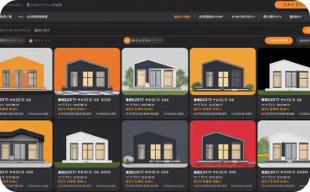
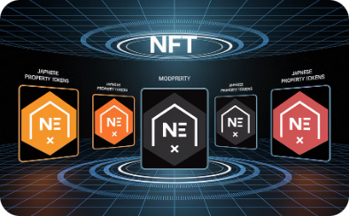
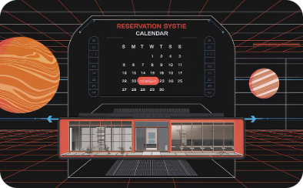
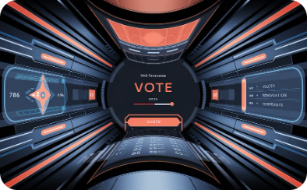
The Akiya Reborn Platform
Property Discovery
NFT Marketplace
Reservation System
DAO Governance
Browse available akiya projects with detailed history, renovation plans, and community potential. Each property features comprehensive information about local attractions and opportunities.
Purchase property-specific NFTs that provide governance rights and accommodation benefits. Different tiers offer varying levels of access and participation in the renovation process.
Book stays at completed properties using a priority system based on NFT holdings. Calendar integration ensures seamless planning for international travelers.
Participate in key decisions about property renovations, event planning, and future expansions through transparent on-chain voting mechanisms.

Slide 5
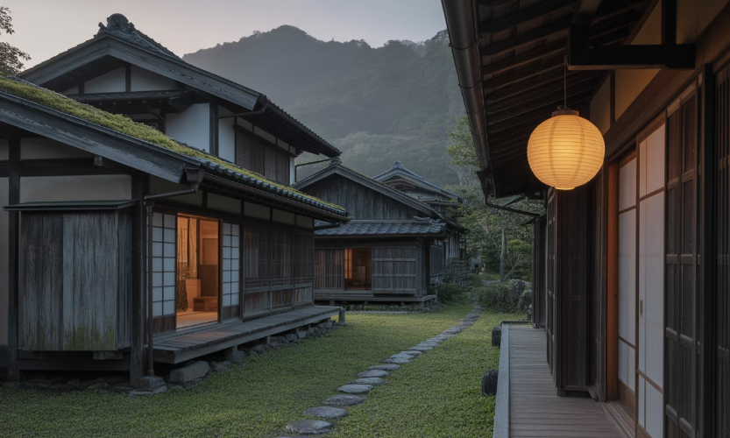
Unlocking Japan's $40B Akiya Market Opportunity
Market Opportunity
¥6 trillion ($40B) in vacant Japanese homes
Perfect Timing
Digital nomads + cultural travel + Web3 utility
Revenue Potential
$5M/year by revitalizing just 0.5% of vacant homes
Vision
Building decentralized cultural infrastructure

Slide 6








Competitive Landscape
Traditional Crowdfunding
Government Initiatives
Platforms like Makuake offer project backing but lack ongoing utility and community engagement beyond initial funding.
Public programs provide subsidies but involve complex bureaucracy and limited international appeal or transparency.
Akiya Reborn (Us)
Hospitality Chains
Our solution uniquely combines Web3 ownership benefits, transparent renovation processes, and ongoing accommodation utility with international appeal.
Traditional accommodations offer consistency but miss authentic cultural immersion and community connection opportunities.
Unlike traditional property investment or crowdfunding platforms, Akiya Reborn leverages blockchain technology to create transparent ownership structures, verifiable renovation tracking, and community governance. This technological foundation provides greater utility, trust, and international accessibility compared to existing solutions.

Slide 7
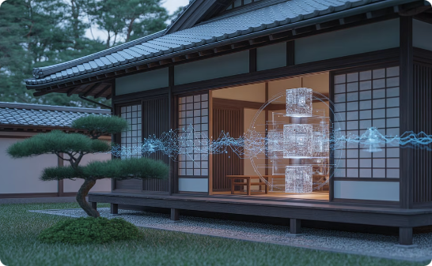


Why We're Building on Solana
Real-World Impact
Technical Advantages
Cultural Network
The Solana ecosystem is hungry for projects with tangible outcomes.
High-speed booking systems
We're building more than a crypto project.
Low-cost NFT minting
Our vision creates a decentralized cultural infrastructure with global reach and local impact.
We connect physical spaces with blockchain technology, creating meaningful experiences.
On-chain governance
Efficient reservation logic

Slide 8
Sustainable Business Model
DAO Treasury
Revenue Sharing
A portion of all revenue flows into the DAO treasury, funding maintenance, future acquisitions, and community-driven initiatives as determined by governance votes.
Booking Fee Structure
Property owners receive 70% of net booking revenue, creating a sustainable income stream that incentivizes more owners to list their akiya properties on our platform, driving organic growth.
NFT Sales Revenue
Once properties are operational, we collect a 15% commission on all bookings made through our platform. NFT holders receive discounted rates, while non-holders pay premium prices for available dates.
Initial funding comes from tiered NFT sales representing fractional benefits in specific akiya properties. Early supporters receive premium access rights and enhanced governance capabilities in the DAO structure.

Slide 9
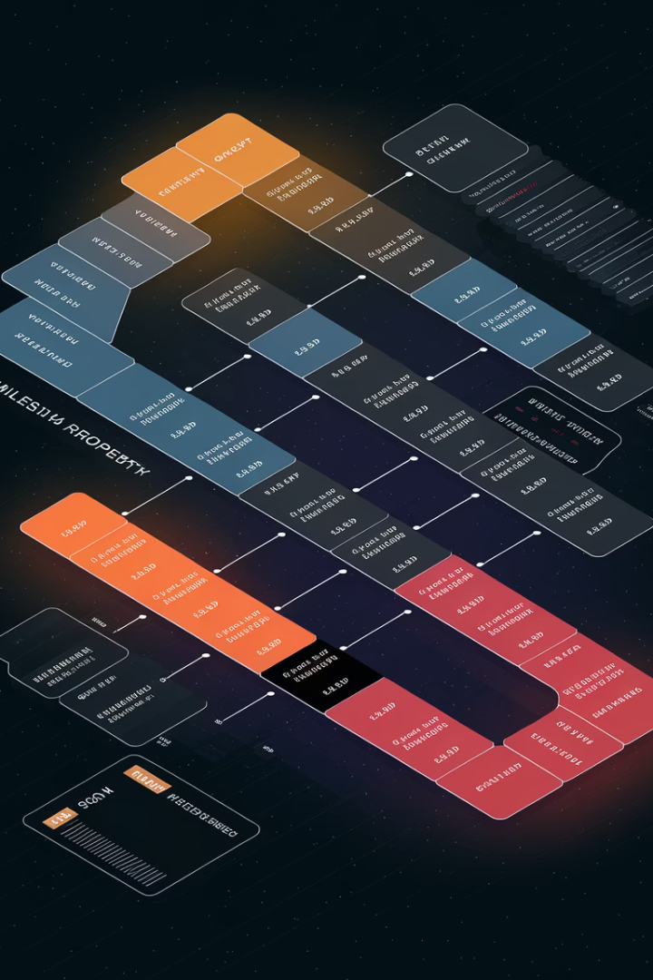




Strategic Roadmap
Q2 2025: Proof of Concept
Launch platform MVP with initial property listings. Begin NFT sales for first flagship akiya renovation project. Establish legal framework and partnerships with local craftsmen.
Q3 2025: First Property
Complete renovation of flagship property. Launch booking system for NFT holders. Implement feedback loop and document success metrics for future scaling.
Q4 2025: DAO Formation
Transition to full DAO governance model. Expand to three additional properties across different regions. Begin international marketing campaign targeting digital nomads and cultural tourists.
Q2 2026: Multi-Region Scaling
Expand to 10+ properties across diverse Japanese regions. Implement cross-property benefits for NFT holders. Develop partnerships with local experience providers.

Slide 10
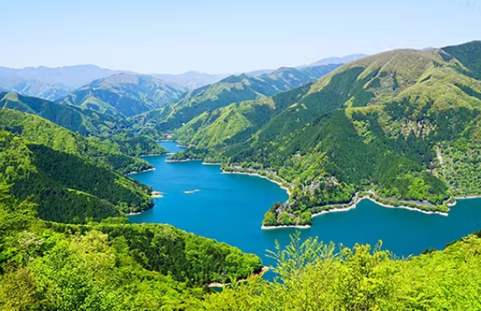
Boots on the Ground
We’re not just planning—we’ve started moving.
✅ We’ve begun scouting akiya properties in Okayama and Okutama, based on real community referrals. ✅ We’ve visited candidate sites and spoken with locals to validate location and livability. ✅ We’re building a regional network of craftsmen, tourism advisors, and legal support. ✅ These ground efforts are shaping the roadmap and informing real-world constraints.
Our first property is not yet selected—but our boots are on the ground, and our direction is clear.
Our first property is not yet selected— but our boots are on the ground, and our direction is clear.

Slide 11
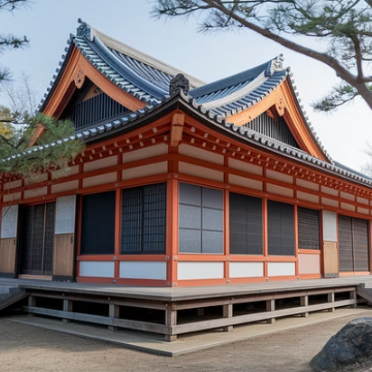
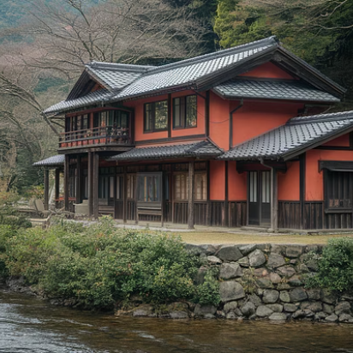
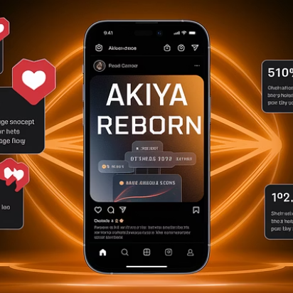
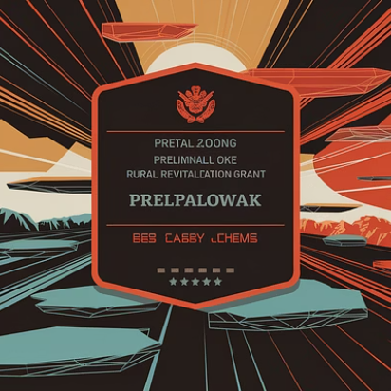
Current Traction
We've identified two promising property candidates: a traditional kominka in rural Okayama with mountain views and a spacious wooden house in Okutama, just two hours from central Tokyo. Both owners have expressed interest in our renovation-for-accommodation model.
Our concept has generated significant interest on social media, with over 500 pre-registrations from potential NFT purchasers and travelers. Additionally, we're in discussions with the Rural Revitalization Agency regarding grant eligibility and have begun exploring partnerships with local craftspeople for authentic renovations.

Slide 12


Our Passionate Team
Let's solve social issues together! Email: info@amemomo.tokyo Discord: sumomo_nosu
G I
M A
Sustainable community engineer and licensed mountain guide. PhD candidate at Hosei University with expertise in medical imaging, biotechnology, and machine learning. Demonstrated commitment to sustainable practices in rural and alpine communities through work with NGOs like the Albanian Alps Alliance.
Dual-lifestyle expert, journalist, and MBA, with deep regional insights. With experience living between Tokyo and rural Hokkaido, she understands the challenges and opportunities of Japan's regional areas. Her background in community organizing helps forge essential local partnerships to unlock the full potential of these regional communities.

